Slide 1


Data
Analytics
For Social Buzz

Slide 2


Today's agenda
Project recap
Problem
The Analytics team
Process
Insights
Summary

Slide 3

j
Social Buzz is a rapidly growing social media and content based company.
Accenture has begun a 3 month POC focusing on these tasks:
An audit of their big data practice
Recommendations for a successful IPO.
An analysis of social buzz content categories that highlights the top 5 categories with the largest aggregate popularity
Project Recap

Slide 4

Problem
Over 100000 posts posted per day in the form of videos ,audios, GIFs etc.
Huge amount of unstructured data is present and it requires highly sophisticated and expensive technology to maintain.

Slide 5


Andrew Fleming (Chief Technical Architect),
The Analytics team
Marcus Rompton (Senior Principle),
Sahil Bodke
Data Analyst

Slide 6
Process
1
Data Observation and Understanding
2
Data Cleaning
3
Data Modelling
4
Data Analytics
5
Gathering insights

Slide 7

Insights
16
1897
JANUARY
Unique Values
Reactions to animal post
Month with most posts

Slide 8
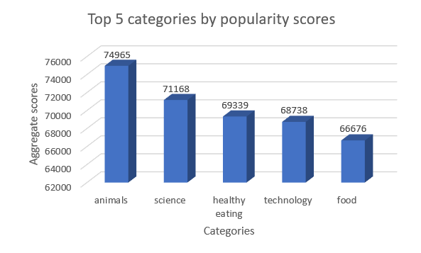

Slide 9
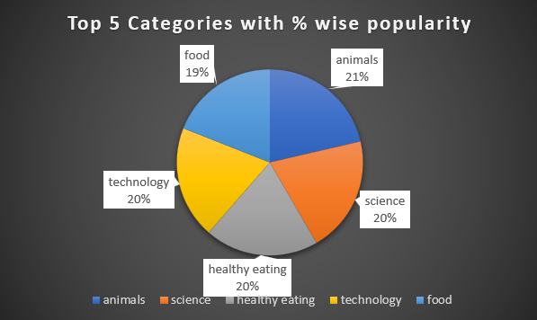

Slide 10

ANALYSIS
Animals and science are the two most popular categories of content, showing that people enjoy "real-life" and "fictional" content the most.
INSIGHTS
According to the data animals is the most viewed and reacted category among all categories. Also food being common in the top 5 categories can be used by the company to work with healthy eating brands and rolling out campaigns related to healthy stuff which can lead to a significant boost in user engagement.
Summary

Slide 11
Thank you!

